Slide 1
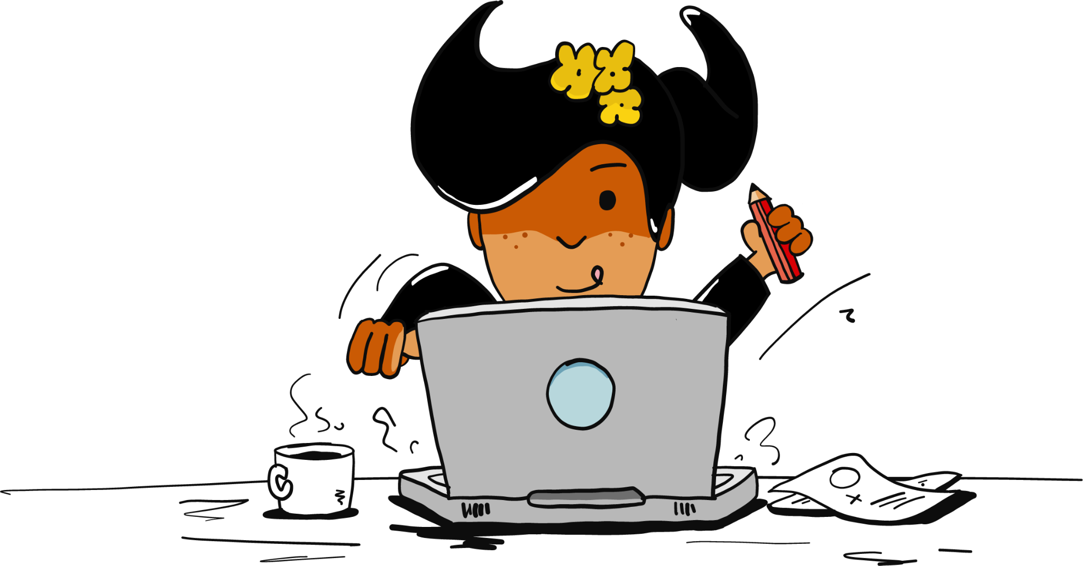



Electric Kiwi Hackathon Team Robin
-Lillian, Fan, Momo, Helen

Slide 2
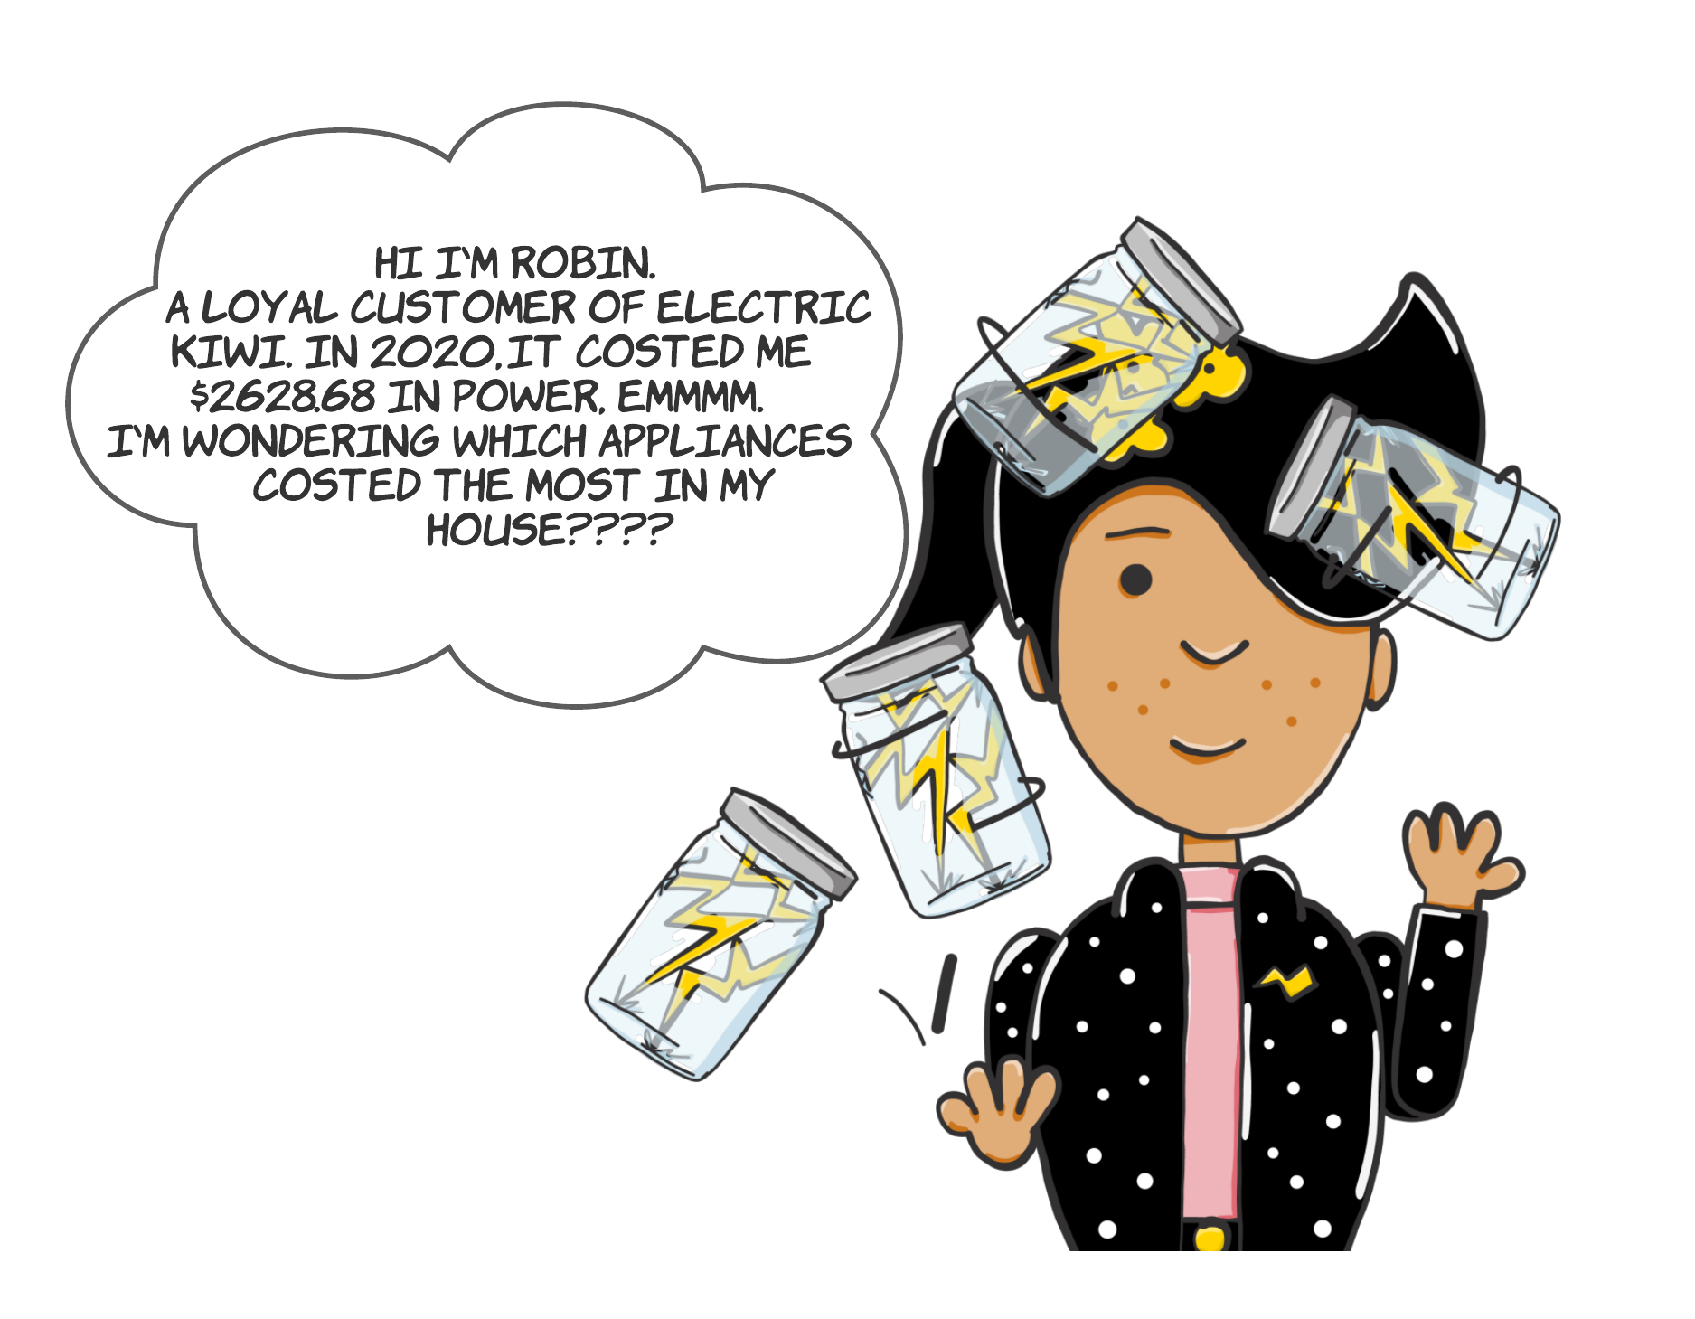
Notes:
Our loyal customer, Robin would like to know more details on his power consumption especially power consumption by appliance.
Let’s see how Robin use this APP and interact with APP.

Slide 3
Our Ideas & Solution
Electric Kiwi App Extension:
Tab 1 - News:
Curated Educational Content
Gamification Rewards
Tab 2 - Empower:
Usage Summary
Appliance Consumption Calculator
Notes:
Tab 1 - News
Tab 2 - Empower

Slide 4
How did you bring the idea to life technically
Software: R (ShinyMobile)
Step 1: design framework based on key metrics
Step 2: implement data model, widgets and outputs to app
Step 3: fine tune visualisation with branding elements

Slide 5

App Demo

Slide 6
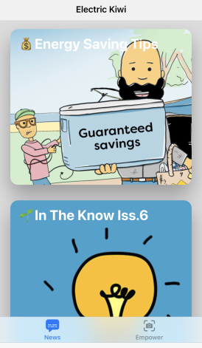
External Data Source
Responsibility:
Dataset 1: Home appliance electricity cost reference
Dataset 2: North Island household electricity consumption
Fan: Team coordination, facilitate communication.
Lillian: Main coder using R Shiny package.
Helen: Data pre-processing and UI design.
Momo: Developing coding infrastructure for graphs and plots.
Dataset collection and analysis, as well as powerpoint presentation preparation are conducted by all team members together.

Slide 7
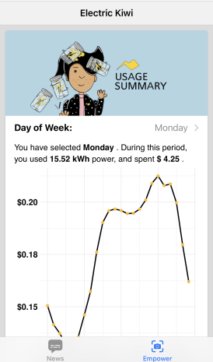
Future Ideas
Gamification programme future directions
Reduce peak hour power usage:
Partner with other sustainability focused companies for potential rewards programme.
Rewards for customers if they could keep below a certain threshold of peak hour power usage a collective number of times

Slide 8
Thanks for Listening!

